Slide 1
Happiest Health Digital Twin Challenge 2026
0.958
spike-alert AUROC on unseen patients
95%
of spikes flagged up to 2 h early
±13.8
mg/dL error, 1-hour forecast
Sugar Twin India
A digital twin of each Type 2 diabetes patient that predicts glucose spikes and lows 2 hours before they happen
Team guptaaayush0908 · Maharaja Agrasen Institute of Technology
Reimagining and Reforming Healthcare in India Summit, Bengaluru
Notes:
Hook: a person with diabetes sees a doctor about four times a year; in between, glucose rises and falls hundreds of times and no one is watching. Sugar Twin India gives every patient a virtual copy of their body that warns the doctor two hours early and lets the doctor test advice before giving it.

Slide 2
Team guptaaayush0908
Maharaja Agrasen Institute of Technology (MAIT), Delhi
AG
DG
DS
Aayush Gupta
Dhruv Gandhi
Divyansh Singh
Team leader
Team member
Team member
Maharaja Agrasen Institute of Technology
Maharaja Agrasen Institute of Technology
Maharaja Agrasen Institute of Technology
Notes:
Introduce Aayush Gupta (team leader), Dhruv Gandhi and Divyansh Singh in one line each: name and what they built.

Slide 3
Diabetes is managed between visits, where no one is watching
1
Harm happens between visits
101 M
people with diabetes in India
ICMR-INDIAB, 2023
Type 2 diabetes is the condition we chose: the most common lifestyle disease in India.
Post-meal spikes from rice-heavy meals and late dinners, festivals, missed doses and night-time lows go unseen for months.
2
A CGM only shows the past
By the time an alarm sounds, the spike or the low is already happening.
3
Too much data for a doctor
288 CGM readings a day per patient, plus a smartwatch and a 3-year health record, for hundreds of patients.
Notes:
Points: 101 million people with diabetes in India. Harm happens between visits. CGMs collect data but only show what already happened, and a doctor cannot read 288 readings a day for hundreds of patients. The EHR knows the history but is not connected to the live stream.

Slide 4
A twin of each patient that warns early and tests advice first
Fuses the electronic health record (static) with CGM and smartwatch data (dynamic)
1
2
3
Triage
Early warning
Advice tested on the twin
Every patient sorted by risk right now: urgent (a low or above 250 likely) and watch (a spike likely).
Spike above 180, above 250 or a low below 70 predicted up to 2 hours ahead, with plain-language reasons.
The patient's own physiology simulates a smaller meal, a walk or a missed dose before the doctor advises it.
Doctor's question answered in seconds: who needs me now, and what should I tell them?
Notes:
Three capabilities. Triage, early warning with reasons, and advice tested on the patient's own physiology twin.

Slide 5
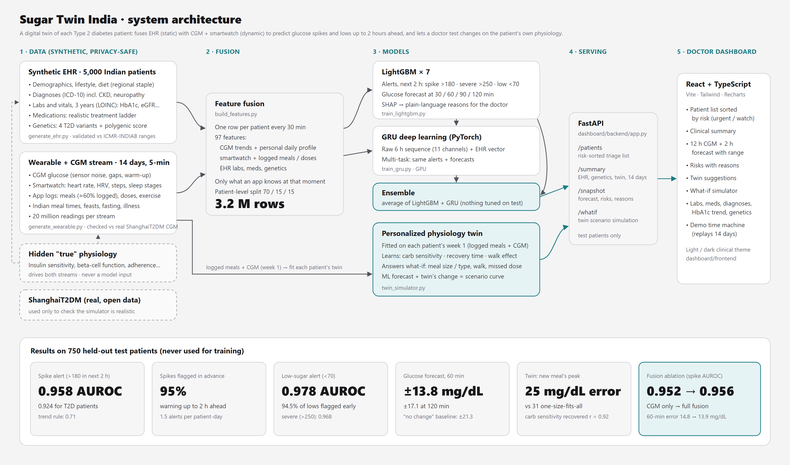
How it works
Notes:
Walk left to right: synthetic EHR and 14 days of 5-minute CGM and smartwatch data; fusion into 97 features every 30 minutes using only what an app would know; LightGBM and GRU predict alerts and the glucose curve; a personal physiology twin answers what-if questions; FastAPI and a React dashboard serve the doctor.

Slide 6
Two data streams, one virtual body
All synthetic: no real patient records (DPDP Act and HIPAA safe)
Static: synthetic EHR · 5,000 Indian patients
Dynamic: wearables · 14 days, every 5 min
Demographics, lifestyle, regional diet
Diagnoses coded in ICD-10
3 years of labs and vitals (LOINC)
Medicines on a realistic treatment ladder
Genetic markers: 4 T2D variants + polygenic score
CGM glucose with sensor noise and gaps
Heart rate, HRV, steps, sleep stages
Logged meals (about 60%), doses, exercise
Indian meal times, feasts, fasting, illness
20 million readings per stream
r = 0.93
82% vs 84%
0
CGM-estimated vs lab HbA1c: both streams describe one body
time in range: simulated vs real ShanghaiT2DM CGM
hidden physiology values given to the models
Notes:
Why synthetic: privacy law and the challenge rules. Both streams are generated from the same hidden physiology so HbA1c, medicines and the CGM curve agree; the hidden values are never model inputs. Realism checked against Indian literature and real ShanghaiT2DM CGM data.

Slide 7
Two kinds of twin: one predicts, one simulates
1
LightGBM × 7
2
GRU deep learning
Alerts for the next 2 h (spike above 180, above 250, low below 70) and forecasts at 30 to 120 min. SHAP gives plain-language reasons.
Reads the raw 6-hour sequence (11 channels) plus the EHR vector; multi-task alerts and forecasts.
3
Ensemble
4
Personal physiology twin
Plain average of LightGBM and GRU: nothing tuned on test patients. Feeds the triage list and the forecast chart.
Learns each patient's carb sensitivity, recovery time and walking effect from week 1; simulates meals, walks and missed doses.
Notes:
ML models predict what will happen. Because they learn correlation, not cause and effect, what-if questions go to the physiology twin.

Slide 8
It sees spikes and lows coming
750 held-out test patients, never used for training
0.958
95%
0.978
±13.8
spike-alert AUROC (0.924 for T2D) vs 0.71 for a trend rule
of spikes flagged up to 2 hours before they happen
low-sugar AUROC; 94.5% of lows flagged early
mg/dL error at 60 min vs ±21.3 assuming no change
Glucose forecast | 30 min | 60 min | 90 min | 120 min
Sugar Twin error (mg/dL) | 10.6 | 13.8 | 15.9 | 17.1
'Glucose stays the same' baseline | 14.1 | 21.3 | 27.3 | 31.7
Spike alerts at 80% sensitivity: precision 0.75, about 1.5 alerts per patient-day. Clarke error grid zones A + B above 99% at every horizon.
Notes:
Honest testing by patient. Spike AUROC 0.958 vs 0.71 trend rule; 95% of spikes flagged early; lows 0.978; forecast error 13.8 mg/dL at 1 hour.

Slide 9
Fusing the streams helps, and personal beats average
Inputs | Spike AUROC | T2D | 60-min error
CGM only | 0.952 | 0.915 | 14.8
CGM + smartwatch + logs | 0.955 | 0.919 | 14.1
CGM + EHR | 0.953 | 0.917 | 14.6
Full fusion | 0.956 | 0.921 | 13.9
Personal twin
25 mg/dL
error predicting a new meal's peak
vs 31 mg/dL one-size-fits-all
Carb sensitivity learned from week 1 matches the hidden truth: r = 0.92
Each stream adds information; full fusion is best for spikes and forecasts. Low-sugar prediction comes mostly from the CGM itself.
Notes:
Fusion ablation: same LightGBM settings on growing feature sets. Twin: personalised parameters predict week-2 meal peaks better than population averages.

Slide 10
Tested the way it will be used
OK
Day 1, no history yet
spike AUROC 0.955
19 of 24 clinical scenario checks pass
Feasts, missed doses, illness, fasting on sulfonylureas, night-time lows, healthy people after a big meal.
The 5 that fail are what-if checks on the ML models (for example, a walk should lower the forecast): they learn correlation, not cause and effect.
That is why what-if questions go to the physiology twin.
OK
Patient never logs meals
0.955
OK
No smartwatch, CGM only
0.956
OK
10% noisier sensor
0.942
Brand-new patient 'Sunita', created outside the dataset
All 48 of her spikes and 18 lows flagged in advance, about 100 minutes early on average.
Notes:
Robustness: cold start, no meal logging, no smartwatch, noisier sensor all pass. Scenario tests: honest about the five failures and why they motivate the twin.

Slide 11
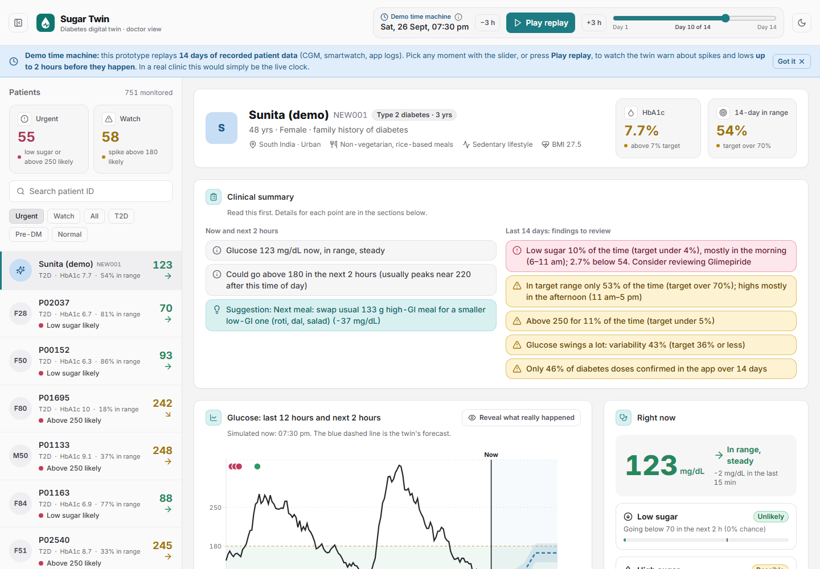
What the doctor sees
Patients sorted by risk: urgent and watch
Clinical summary in plain language
12-hour CGM plus 2-hour forecast with likely range
Risks with reasons from the model
Twin suggestions with their simulated effect
Dropdowns: what-if, health record, genetics, accuracy
Demo time machine replays 14 days
Notes:
Demo flow: triage list, clinical summary, forecast chart with reveal, play the replay to watch an alert appear before a spike, reasons, suggestions.

Slide 12
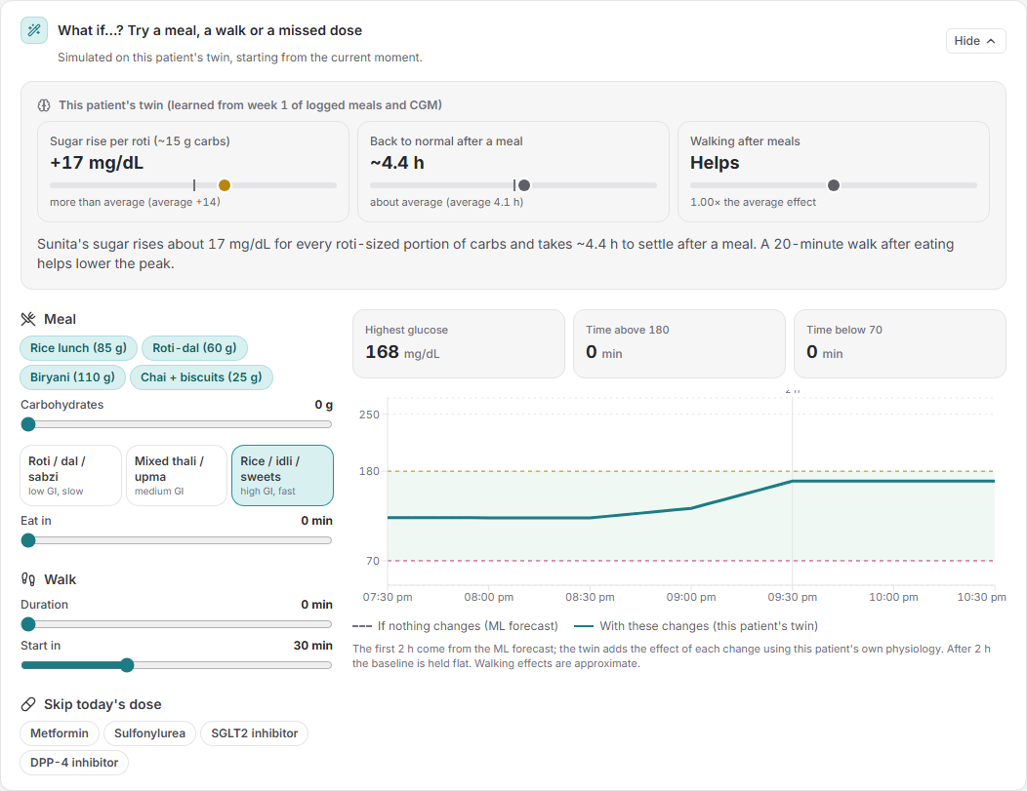
Advice tested on the patient's own twin
The twin learns three things
How much 10 g of carbs raises glucose, how fast it recovers, and how much a walk helps, from week 1 of logged meals and CGM.
The doctor tries a change
Meal size and type, a walk after eating, or a missed dose: the curve updates against 'if nothing changes'.
Example: Sunita
Swapping her usual 133 g high-GI meal for a smaller low-GI one lowers the predicted peak by about 37 mg/dL.
Notes:
Click Try it on a suggestion, show the twin profile, change meal type, add a walk, skip a dose.

Slide 13
Honest limits and what comes next
Limitations
Next steps
All data is synthetic; accuracy on real patients will be lower
The twin shares equations with the simulator, so its recovery of physiology is an upper bound
Low-sugar alerts are sensitive but give false alarms (about 3 in 4)
Warning time is measured on a 30-minute grid
Validate on real, consented CGM data with a partner hospital
Re-fit each twin continuously as new meals are logged
Patient app with an 'I'm about to eat' button (spike AUROC 0.975 with a meal plan)
Same EHR + wearable fusion for hypertension and cardiovascular risk
Notes:
Say the limitations plainly; juries trust teams that do. Then next steps.

Slide 14
Sugar Twin India
Who needs me now, and what should I tell them?
A digital twin that answers the doctor's question in seconds, two hours before the event.
github.com/Aayushg0908/sugar-twin-india
Team guptaaayush0908 · Maharaja Agrasen Institute of Technology · MIT License
All patient data is synthetic. Decision-support prototype, not a medical device.
Notes:
Close: Sugar Twin turns a stream of numbers into one question a doctor can answer in seconds. Thank you. Show the GitHub link.

